Slide 1





C7084 Big Data
Ed Harris
QUERY
DATA
Knowledge

Slide 2

BIG
DATA

Slide 3
Table of Contents
Don't forget to start recording
Every session: community.cloud.databricks.com and Logon
In Left-pane, Click on 'Clusters' or 'Compute' and Terminate old Cluster Then click 'Create Cluster' button to create New one
Mod 00 – Intro and Setup
Mod 01 – Spark Architecture
Mod 02 – SparkSQL (Read/Write DataFrames/Tables)
Hacktivity 00 (Dates) / Hacktivity 01 (Air)
Mod 03 – SparkSQL (Transform)\
Mod 04 – Complex Data Types
Mod 05 – JSON (Optional)
Hacktivity 02 (Fly)
Mod 06 – Streaming
Mod 07 – Architecture-Spark UI
Mod 08 – Catalog-Catalyst-Tungsten
Mod 09 – Adaptive Query Execution
Mod 10 – Performance Tuning
Hacktivity 03 (Stream) / Hacktivity 04 (Air)
Mod 11 – Machine Learning

Slide 4
Module 04 – Complex Data Types

Slide 5
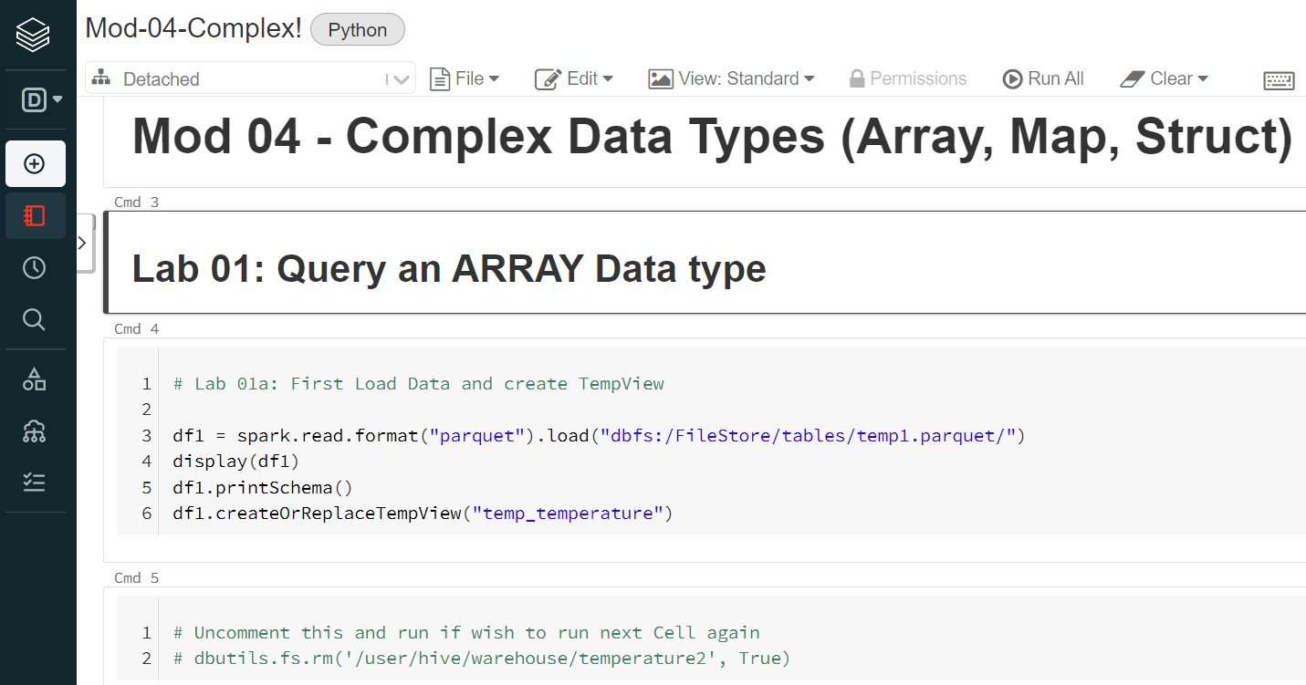
Before We Begin – Open Mod04 Notebook
3

Slide 6
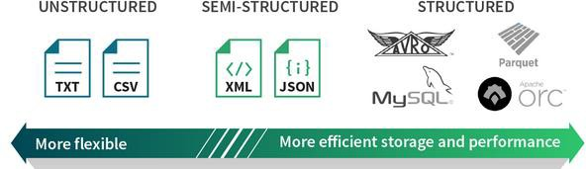
Objectives
4
Learn how to use complex Data types including:
– Standard functions for Collections
─ Array
─ Map
─ Structs
─ JSON
We will be using above Data files on Complex Data types

Slide 7

Topics
5
Data Type Overview
Complex Data Type and functions
Where to source
Array
Map
Struct
Putting it All Together
Hackathon
Querying JSON objects
Summary

Slide 8
Current Topic
6
Data Type Overview
Complex Data Type and functions
Where to source
Array
Map
Struct
Hackathon
Putting it All Together
Querying JSON objects
Summary

Slide 9
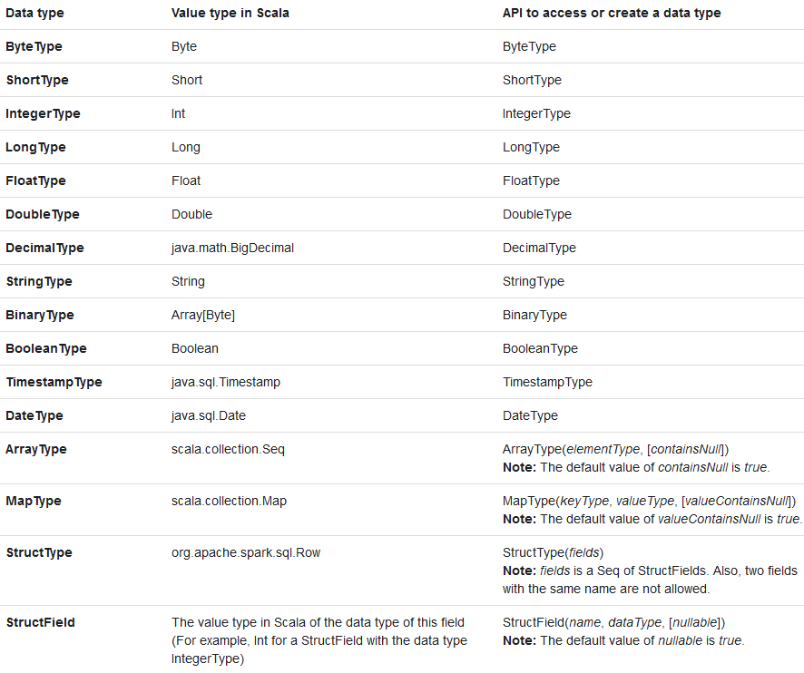

Spark SQL Data Types
7
8-bit (-127 to 128) 16-bit (-32768 to 32767) 32-bit (-2147483648 to 32147483647) 64-bit (-9223372036854808 to 9223372036854775807)
 | 32-bit 64-bit Up to 38 precision
16-bit/character 100 bytes 8-bit 64-bit
'ArrayType', 'MapType' and 'StructType' are useful for data that have arbitrary length

Slide 10
Standard functions for Complex Data Types (DML)
8
from_json
array_contains
explode
explode_outer
size
posexplode
posexplode_outer
reverse* (2.4)
map_keys
Extract JSON values into Struct/Array Used with WHERE|FILTER function 1:Many transformation from Array/Map
1:Many transformation from Array/Map column (& Nulls) Returns count of Parts of given Array/Map
Returns position and col value from Array
Returns position and col value from Array (& Null Arrays)
Returns reversed string/Array with reverse order Returns just 'key' from Map
map_values Returns just 'value' from Map
element_at Returns element of array if col in array. Returns value for given key if col is map
12. collect_set
Returns a set of objects with duplicate elements eliminated
https://databricks.com/blog/2018/11/16/introducing-new-built-in-functions-and-higher-order-functions-for-complex-data-types-in-apache-spark.html
https://jaceklaskowski.gitbooks.io/mastering-spark-sql/spark-sql-functions-collection.html
https://stackoverflow.com/questions/39739072/spark-sql-how-to-explode-without-losing-null-values

Slide 11
Can source Complex Data Types from Hive tables
9
Spark can leverage the 3 Complex data types from Hive tables
create table Temperature
( dt string, city string, mytemps array <double> )
row format delimited fields
terminated by '\t' collection items terminated by ',';
create table MySchools
(schooltype string,state string,gender string, total map <int,int>) row format delimited fields terminated by '\t' collection items terminated by ‘,’ map keys terminated by ':';
create table MyBikes
(name string, BikeFeatures struct<EngineType:string,cc:float,power:float,gears:int>)
row format delimited fields terminated by '\t' collection items terminated by ',';
Most complex data types are hosted on Hive tables or structured files

Slide 12



CSV doesn't support Array (1 of 3)
10
Although possible to use unstructured files(like CSV) with Complex data types, you typically must use functions to manipulate the data beforehand. Common functions include: concat, col, lit, na.fill, withColumn, etc.
Without manipulation, CSV will not fail during Action
Array
import org.apache.spark.sql.types._
val schema1 = StructType(Array(StructField("dt", StringType, true),
StructField("city", StringType, true), StructField("mytemp", ArrayType(FloatType, true)))
val df.spark.read.format("csv").option("sep", "\t").schema(schema1).load("file:/opt/temperature.tsv")
df.printSchema()
df.show()

Slide 13



CSV doesn't support Map (2 of 3)
11
Here's a Map example
Map
import org.apache.spark.sql.types._ val schema1 = StructType(Array(StructField("name", StringType, true),
StructField("grades", MapType(StringType, IntegerType), true))) val df.spark.read.format("csv").option("sep", "\t").schema(schema1).load("file:/opt/school_map.tsv") df.printSchema() df.show()

Slide 14


CSV doesn't support Struct (2 of 3)
12
Here's a Struct example
Struct
import org.apache.spark.sql.types._
val AttribSchema = StructType(StructField("wt", IntegerType) ::
StructField("mpg", FloatType) ::
StructField("trans", StringType) :: Nil)
val schema1 = StructType(StructFIeld("name", StringType) :: StructField("attribute", attribSchema) :: Nil) val df.spark.read.format("csv").option("sep", "\t").schema(schema1).load("file:/optauto_struct.tsv")
df.printSchema()
df.show()

Slide 15
Current Topic
13
Data Type Overview
Complex Data Type and functions
Array
Map
Struct
Putting it All Together
Hackathon
Querying JSON objects
Summary
https://databricks.com/blog/2017/06/13/five-spark-sql-utility-functions-extract-explore-complex-data-types.html https://docs.databricks.com/spark/latest/spark-sql/complex-types.html

Slide 16
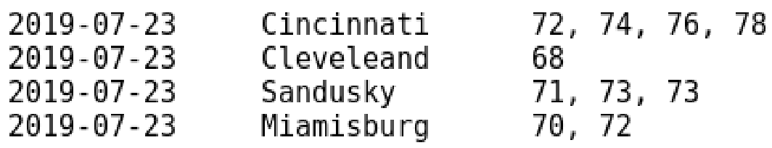
Array Definition
14
Arrays are collection of variable length elements of similar data types
(ie: String, Int, Date, etc)
You pluck out Individual Array elements via Index number (starting at 0)
parent_column.[<Index #>]
In file below, Temperature.tsv has fields delimited by tab and the complex
data type Array values are delimited by ','
Array
4 elements
1 element
3 elements
2 elements
Input file

Slide 17
Array in a Hive table
15
In below Hive table, we create an Array data type
'mytemp' is the Parent column as defined in CREATE TABLE statement
The Input file has 4 possible Index numbers
Array
0-3 Index
0 Index
0-2 Index
0-1
Parent column
Input file
create table temperature
( dt date, city string, mytemp array<double> ) row format delimited fields terminated by '\t' collection items terminated by ',';
Hive

Slide 18
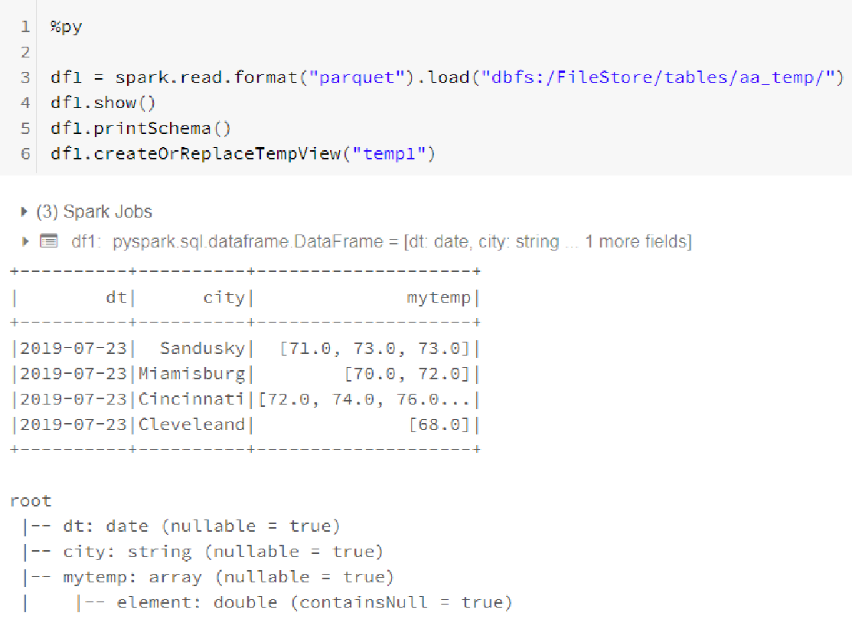
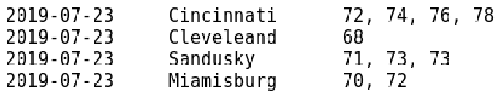
Lab 01a
Create TempView from DataFrame
16

Slide 19
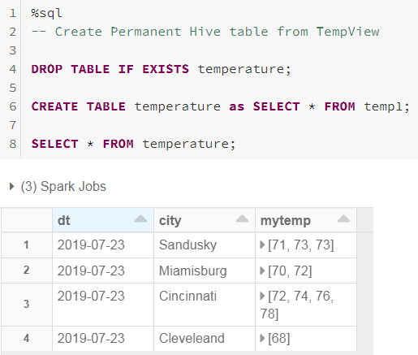
Lab 01b
Create Permanent Table from TempView
17

Slide 20
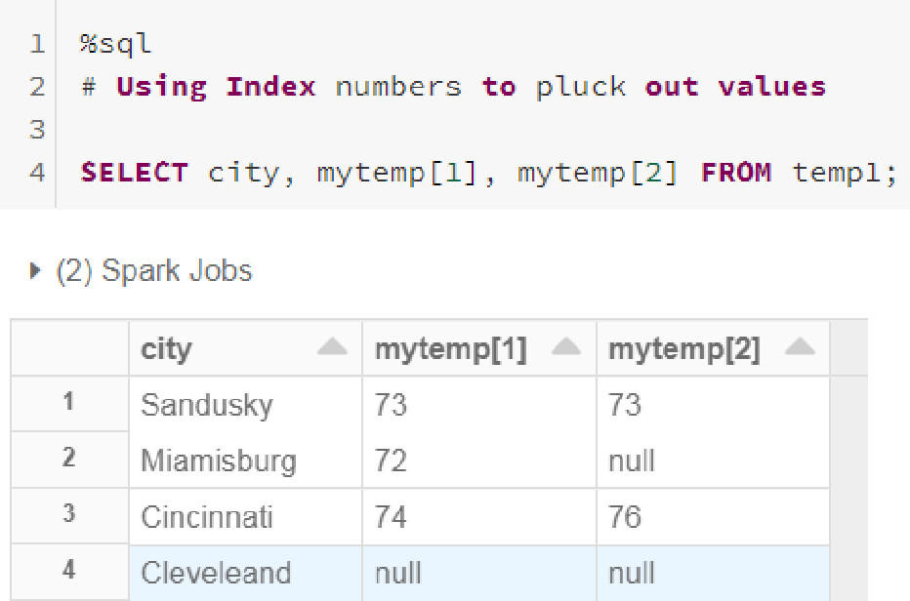

Lab 01c
Query an Array from TempView
18
Via Spark client, to pluck out an Array part, you use Index # starting at 0.
Square brackets are around the Index # preceded by Array column name
Input

Slide 21

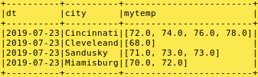

Lab 01d
Query an Array from DF using array_contains
19
I can pull Complex data type objects from Hive tables or Parquet files into DataFrame/View with no issues
val df = spark.table("temperature")
df.printSchema() df.show(5, false)
df.select("city").where(array_contains (df.mytemp, 68.0)).show()
https://stackoverflow.com/questions/34833653/filter-spark-dataframe-with-row-field-that-is-an-array-of-strings

Slide 22
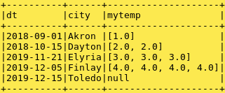

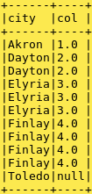
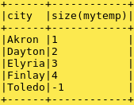
Lab 02 Query an Array from Spark DF
using explode, explode_outer, size
20
val df = spark.table("temp_array_null")
df.show(20, false)
// 'explode' will not display the NULL Array rows df.select($"city", explode($"mytemp")).show(20, false)
// 'explode_outer' will display the NULL Array rows df.select($"city", explode_outer($"mytemp")).show(20, false)
// 'size' will count values in Array (-1 = Null Array) df.select($"city", size($"mytemp")).show(20, false)
Some Spark versions won't display NULL row

Slide 23
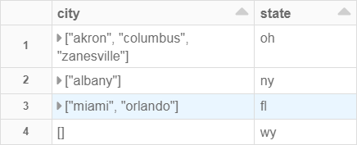
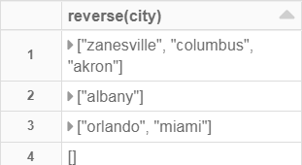
Lab 03
Query an Array from DF using reverse
21
Reverses Parts of Array
val df = spark.table("state_city_array")
df.show(20, false)
df.select($"state", $"city").show(5, false)
// 'reverse' will reverse Parts in Array df.select($"state", reverse($"city")).show(5, false)

Slide 24


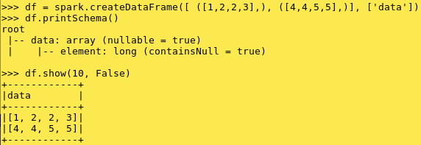

Lab 04
Create an Array on-the-fly
22
val df = Seq( ("beatles", "help|penney lane")
("supertramp", "breakfast in America").toDF("band", "songs")
val bandDF = df.withColumn("songs", split(col("songs"), "\\|")) bandDF.printSchema
Python equivalent
bandDF.show(2, false)
https://medium.com/@mrpowers/working-with-spark-arraytype-and-maptype-columns-4d85f3c8b2b3

Slide 25
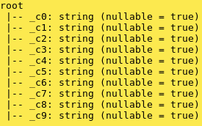
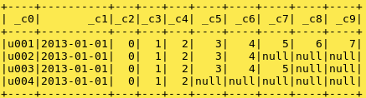
Demo: Lab 7.02g (In AdvSpark:Mod 07 Notebook)
Create an Array DF from file
23
import org.apache.spark.sql.functions._ import org.apache.spark.sql.Column
val df1 = spark.read.csv("file:/opt/array_file1.csv")
df1.printSchema()
Goal: Make _c2 to_c9 an Array
df1.show()
https://stackoverflow.com/questions/47824961/how-to-load-the-csv-file-into-the-spark-dataframe-with-arrayint?rq=1

Slide 26
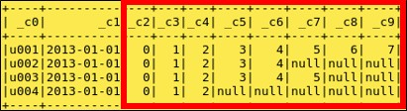

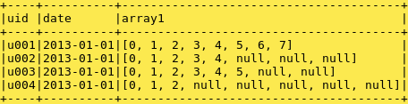
Demo: Lab 7.02g
Create an Array DF from file (2 of 2)
24
// Create column by combining _c2 – _c9 data into Array
val array1: Column = array( df1.columns.drop(2).map(col): _*)
.cast("array<int>")
// Skip first 2 columns
// Cast to required type
// Put all columns back together
val cols: Array[Column] = df1.columns.take(2).map(col) :+ array1
val df2 = df1.select(cols: _*).toDF("uid", "date", "array1") df2.printSchema()
df2.show()

Slide 27
Current Topic
25
Data Type Overview
Complex Data Type functions
Where to Source
Array
Map
Struct
Putting it All Together
Hackathon
Querying JSON objects
Summary

Slide 28
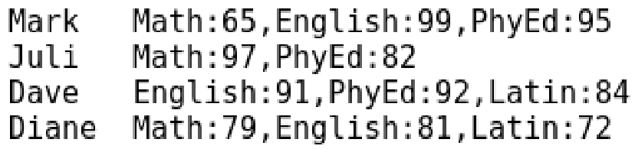
Map Definition
26
Map is a collection of variable length 'Key-Value' pairs
Maps represent multiple fields of a single item
All 'Keys' are one data type and all 'Values' are one data type
An element in Map can be accessed using DOT (.) notation as follows:
You point to a 'Key', 'Value' for that key returned
DataFrame format = parent_column.key_column
SQL format = parent_column[key_column]
In below file, school_map.tsv has fields delimited by tab and the complex data type Map data type are delimited by ':'
3 k-v pairs
2 k-v pairs
3 k-v pairs
3 k-v pairs
Input file

Slide 29
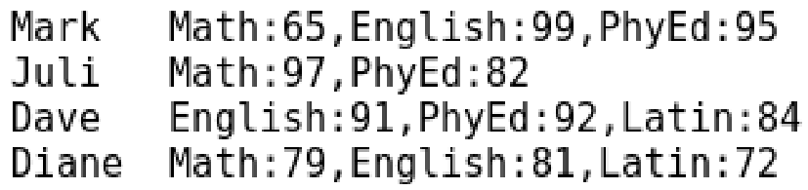
Map in Hive table
27
In below Hive table, we create a MAP data type
'grade' is the Parent column as defined in CREATE TABLE statement
Child columns are defined in Input file (ie: Math, English, PhyEd, Latin)
'Key' columns: Math, English, PhyEd, Latin
Input file
Parent column
create table school
( name string, grades map<string, int> )
row format delimited fields terminated by '\t'
collection items terminated by ','
map keys terminated by ':';
Hive

Slide 30
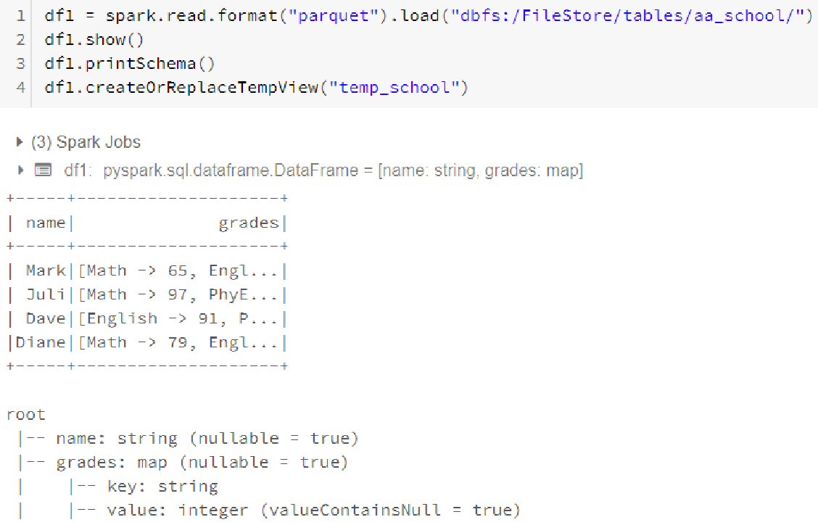
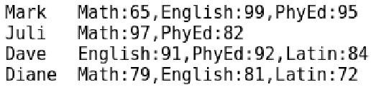
Lab 05a
Create TempView first
28
To pluck out Map 'Value', point to 'Key' using [] syntax (For example: column[key])
Input

Slide 31
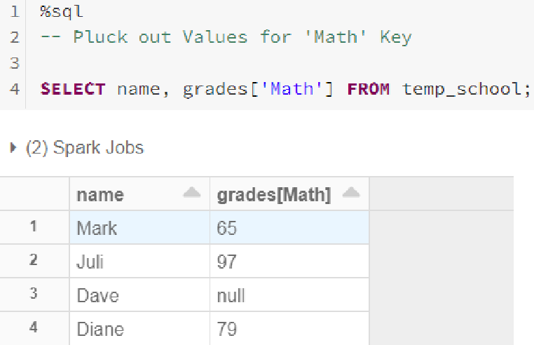
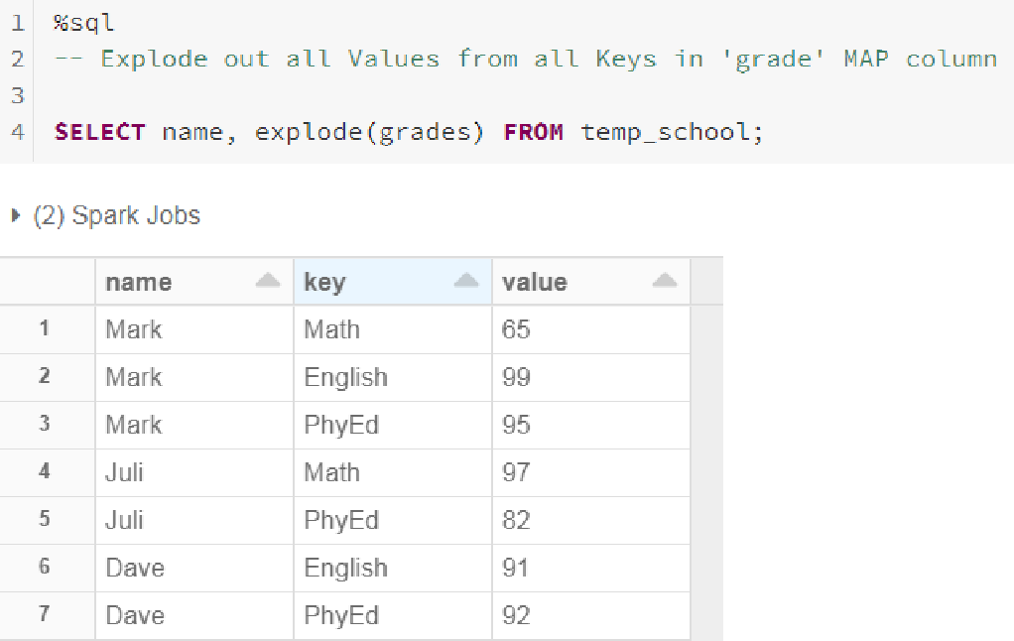
Lab 05b/c
Query Map from TempView
Input
29

Slide 32
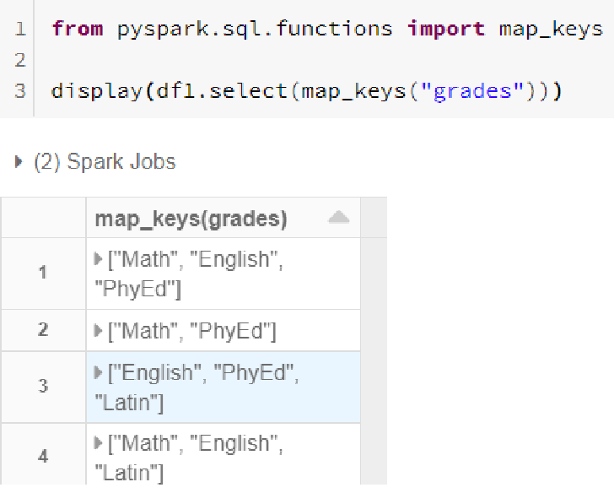
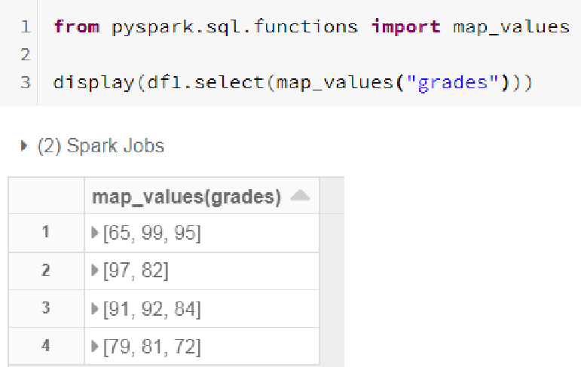
Lab 05d/e Query Map from DataFrame
using map_keys and map_values
30

Slide 33

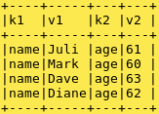

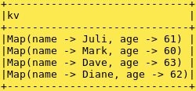

Lab 06
Create Map DF from file using create_map
31
from pyspark.sql.functions import create_map
df1 = spark.read.csv("file:/opt/names1.csv", inferSchema=True, header=True) df1.printSchema()
df1.show(5, False)
df2 = df1.select(create_map("k1", "v1", "k2", "v2").alias("kv")) df2.printSchema()
df2.show(5, False)
df2.select ("kv.name").show(5 , False)

Slide 34
Current Topic
32
Data Type Overview
Complex Data Type functions
Array
Map
Struct
Putting it All Together
Hackathon
Querying JSON objects
Summary

Slide 35
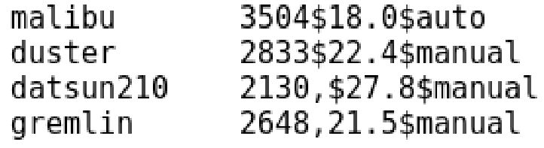
Struct Definition
33
Struct objects contain a list of StructField objects that define the name, type, and nullable flag for each column in a DataFrame. Structs represent multiple fields of a single item
The names and number of fields within the Struct are fixed. Each field can be a different type. A field within a Struct can also be another Struct, or an Array or a Map, allowing you to create nested data structures
An element in Struct can be accessed using DOT (.) notation as follows:
parent_column.child_column
In below file, fields are tab-delimited and Struct has 3 elements delimited by '$'
Input file

Slide 36

Struct in a Hive table
34
The dataset auto_struct.tsv has fields delimited by tab and the Complex data
type Struct is delimited by '$'
Input file
Parent column 3 Child columns
create table auto
( name string, attribute struct<wt : int, mpg : float, trans : string> ) row format delimited fields terminated by '\t'
collection items terminated by '$'
Hive

Slide 37
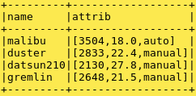
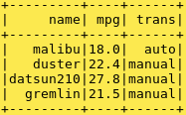

Lab 07a
Query Struct from DF
35
To pluck out Struct, point to 'sub-column' using dot notation
(For example: column.sub-column)
df1 = spark.read.parquet("dbfs:/FileStore/tables/aa_auto/") df1.createOrReplaceTempView("temp_auto")
df1.show()
df1.select("name", "attrib.mpg", "attrib.trans").show() df1.printSchema()

Slide 38
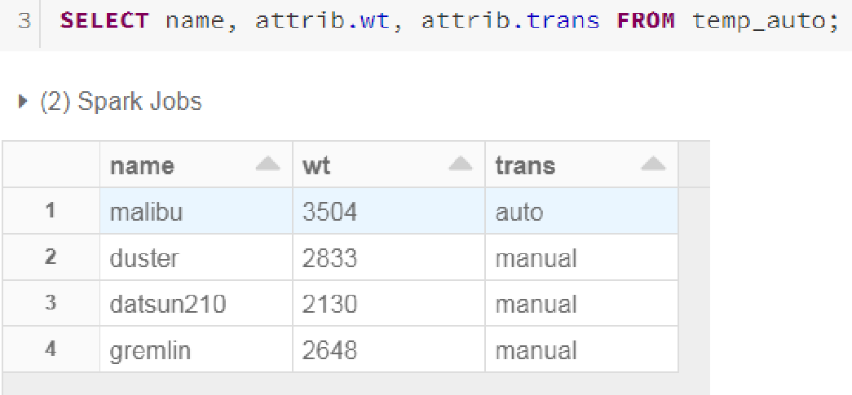
Lab 07b
Query Struct from TempView
36
To pluck out Struct, point to 'sub-column' using dot notation
(For example: column.sub-column)

Slide 39
Current Topic
37
Data Type Overview
Complex Data Type and functions
Array
Map
Struct
Putting it All Together
Hackathon
Querying JSON objects
Summary
https://databricks.com/blog/2017/06/13/five-spark-sql-utility-functions-extract-explore-complex-data-types.html https://docs.databricks.com/spark/latest/spark-sql/complex-types.html

Slide 40
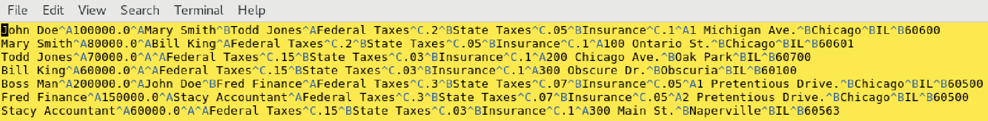
Putting it All Together: Here's the Data file for Hive table
38
Here are the default delimiters for Hive file for the 3 Complex Data types
Rows are delimited by a New Line
Fields are delimited by CTRL+A
Collections are delimited by CTRL+B (Array/Struct/between Maps)
Maps are delimited by CTRL+C (Within Maps, ie: Key ^C Value)

Slide 41
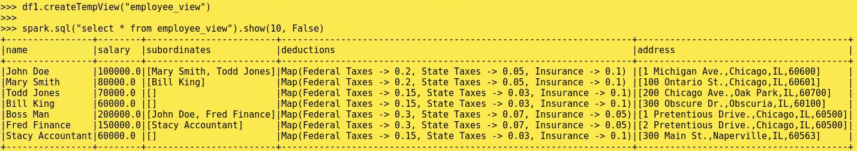
Hive table with 3 Complex Data types
39
beeline> CREATE EXTERNAL TABLE employees ( name STRING, salary FLOAT, subordinates ARRAY<STRING>,
deductions address
MAP<STRING, FLOAT>,
STRUCT<street:STRING,city:STRING,state:STRING, zip:INT>);
beeline> LOAD DATA local inpath '/opt/employees.txt' into table employees; beeline> DESCRIBE employees;
beeline> SELECT * from employees;
array
map
struct

Slide 42
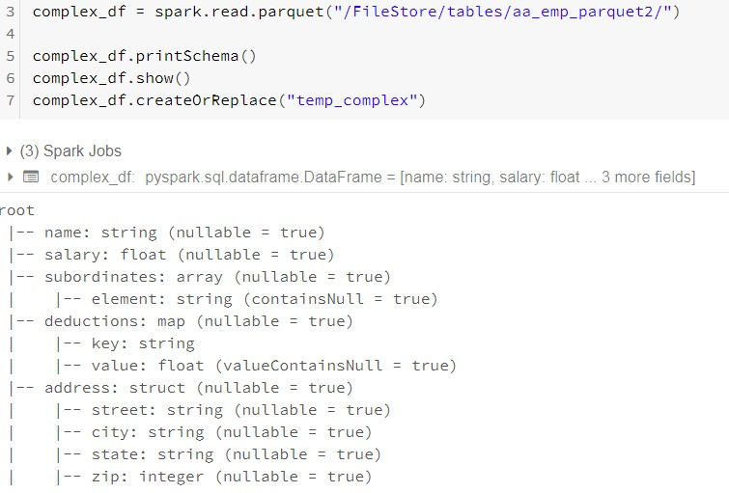
Lab 08a/c
SparkSQL Complex Data Type review
40
Here are 3 complex data types in DataFrame:
Array (always same data type)
Map (Key-Values pairs)
Struct (Different data types)
Next 3 slides show how to pluck out portions of these arbitrary length unstructured data
array
map
struct

Slide 43
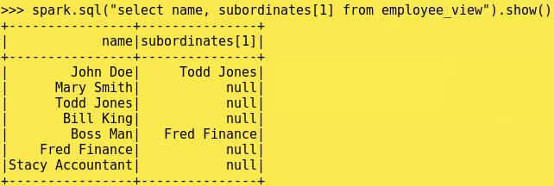
Lab 08d
Array query on TempView
41
Pluck out Index 1 from subordinates column
 | array

Slide 44
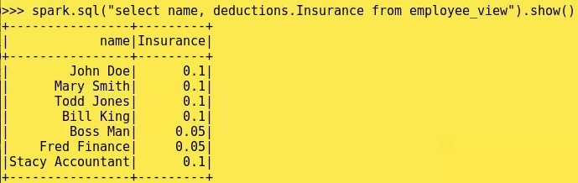
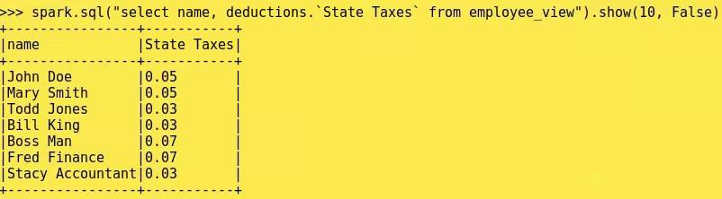
Lab 08e
Map query on TempView
42
Pluck out 'Value' for specified 'Key' = 'Insurance' from deductions column
map
Extra credit: How do you SELE 'State Taxes' column?
CT the

Slide 45
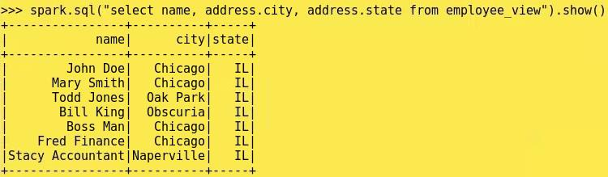
Lab 08f
Struct query on TempView
43
Pluck out 'city' and 'state' from address column
struct

Slide 46
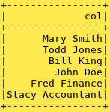
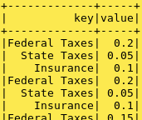
Lab 08g/h
SparkSQL: Using 'explode' with Array/Map
44
SELECT explode(subordinates) FROM temp_complex;
SELECT explode(deductions) FROM temp_complex;
explode() is a 1:M transformation.
In other words, take one row and explode it out to multiple rows.
Similar to flatMap() function
array
map

Slide 47
Current Topic
45
Data Type Overview
Complex Data Type and functions
Array
Map
Struct
Putting it All Together
Hackathon
Querying JSON objects
Summary

Slide 48
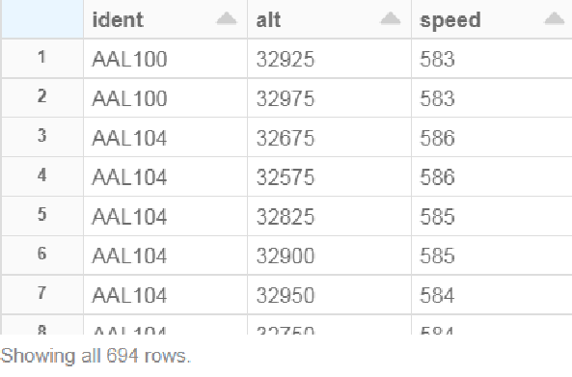
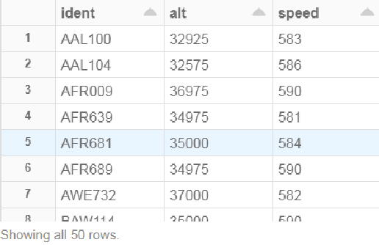
Hackathon
Data is in this file:
site02-201410.tsv
46
Here's the multi-structured flight data. It is tab-separated.
Each flight can have up to 10 Column names as follows:
(clock, hexid, ident, squawk, alt, speed, airGround, lat, lon, heading)
Query: Display IDENT, ALT and SPEED where ALT > 30000 and LAT is not NULL and SPEED > 580 and IDENT is not NULL. Sort by IDENT, SPEED Descending
This has duplicate IDENTS
Extra Credit if can display Max
speed for distinct IDENT

Slide 49
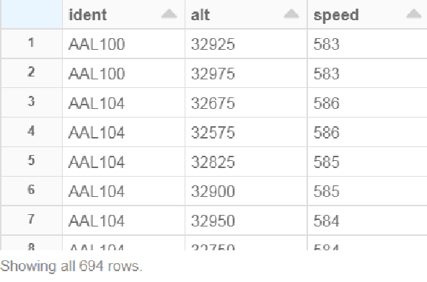
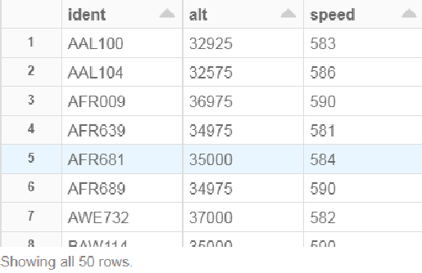
Hackathon – You have 2-4 hours
47
Working in Teams, come up with a way to query this multiple structured data
Later on each time will present their finding and code they used
Query: Display distinct IDENT, ALT and SPEED
where ALT > 30000 and LAT IS NOT NULL and SPEED > 580
and IDENT is not NULL. Sort by IDENT, SPEED Descending
This has duplicate IDENTS
Extra Credit if can display Max speed for distinct IDENT

